Slide 1
BIEN 401 Biomedical Mass Transport Class 7 Diffusion with Convection and Sherwood Number
notes prepared by
Dr. Louis Reis
Created on 3/19/2022

Slide 2
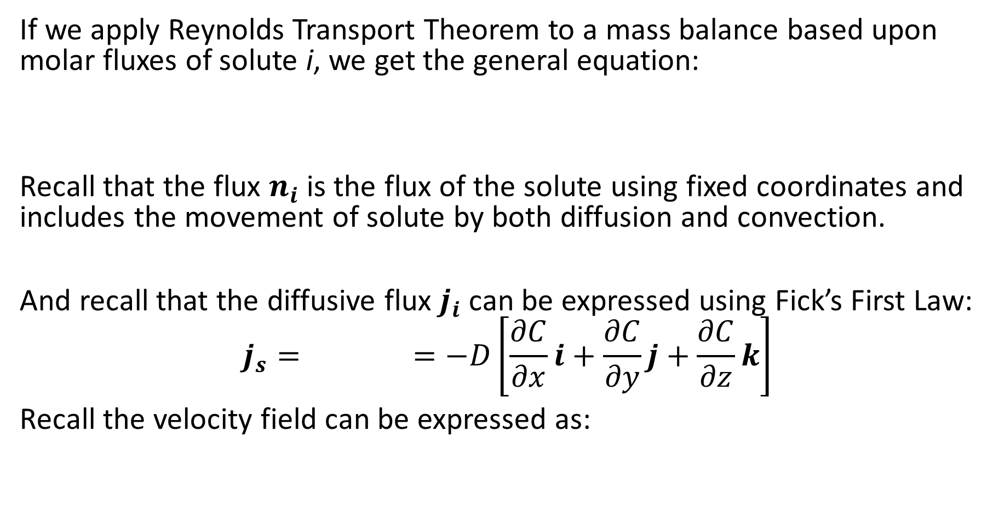
Conservation of Mass
If we apply Reynolds Transport Theorem to a mass balance based upon molar fluxes of solute i, we get the general equation:
Recall that the flux $n_{i}$ is the flux of the solute using fixed coordinates and includes the movement of solute by both diffusion and convection.
And recall that the diffusive flux $j_{i}$ can be expressed using Fick’s First Law:
$$j_{s}= =−D\left[\frac{∂C}{∂x}i+\frac{∂C}{∂y}j+\frac{∂C}{∂z}k\right]$$
Recall the velocity field can be expressed as:

Slide 3
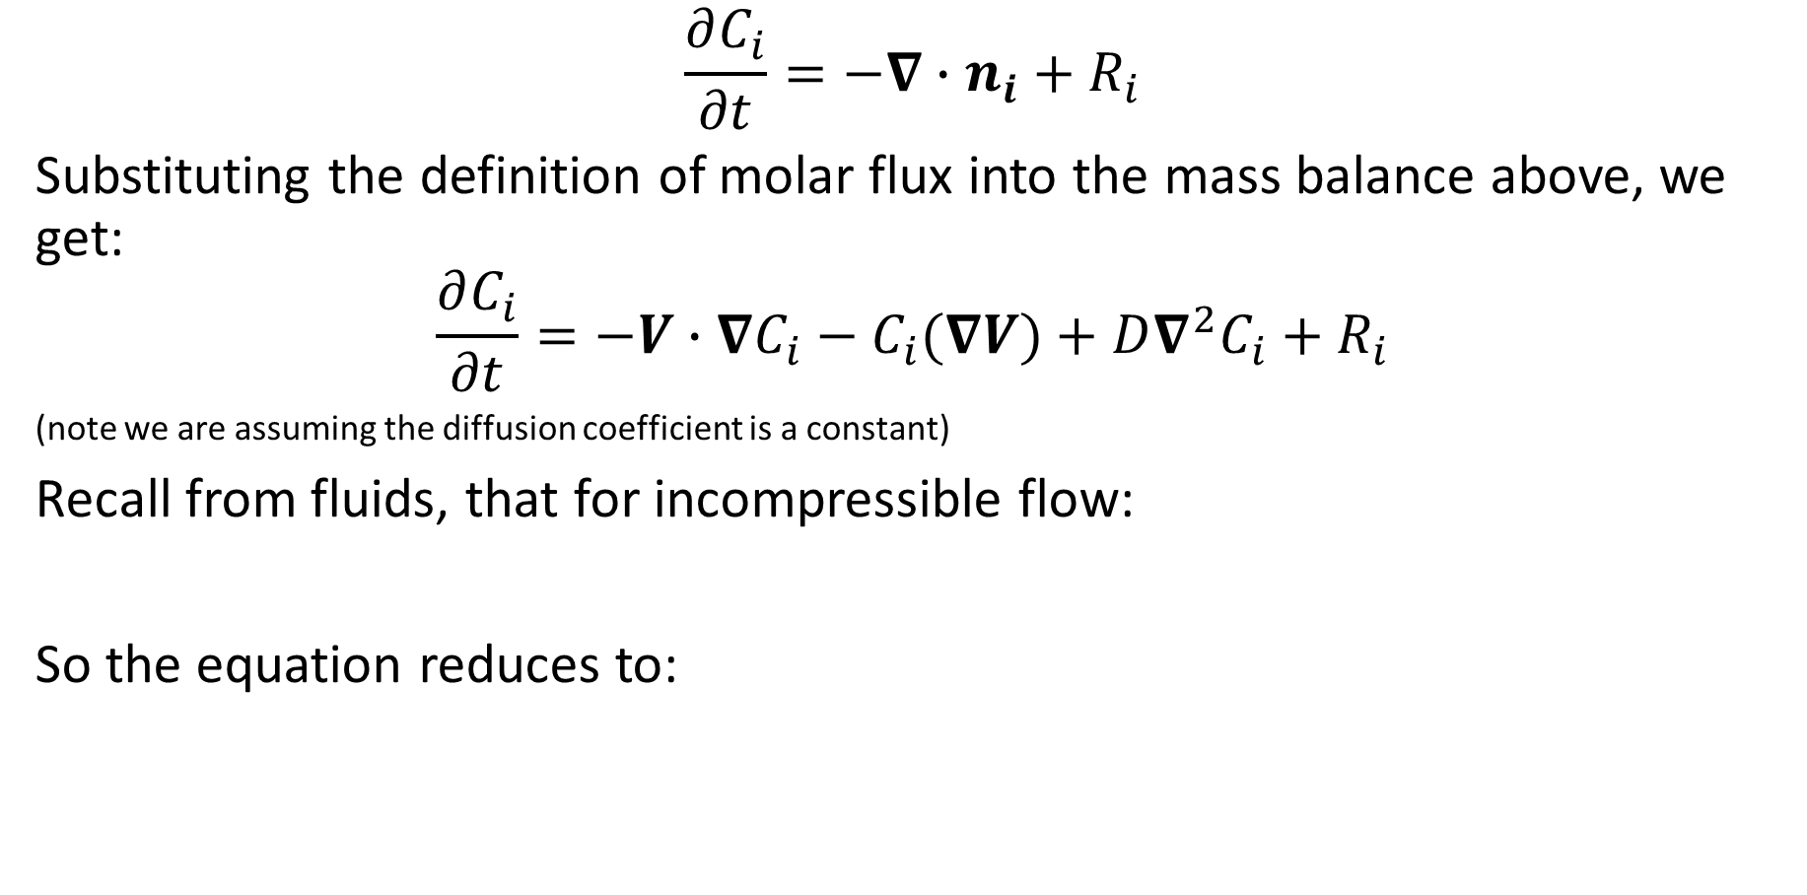
Conservation of Mass
$$\frac{∂C_{i}}{∂t}=−∇∙n_{i}+R_{i}$$
Substituting the definition of molar flux into the mass balance above, we get:
$$\frac{∂C_{i}}{∂t}=−V∙∇C_{i}−C_{i}(∇V)+D∇^{2}C_{i}+R_{i}$$
(note we are assuming the diffusion coefficient is a constant)
Recall from fluids, that for incompressible flow:
So the equation reduces to:

Slide 4
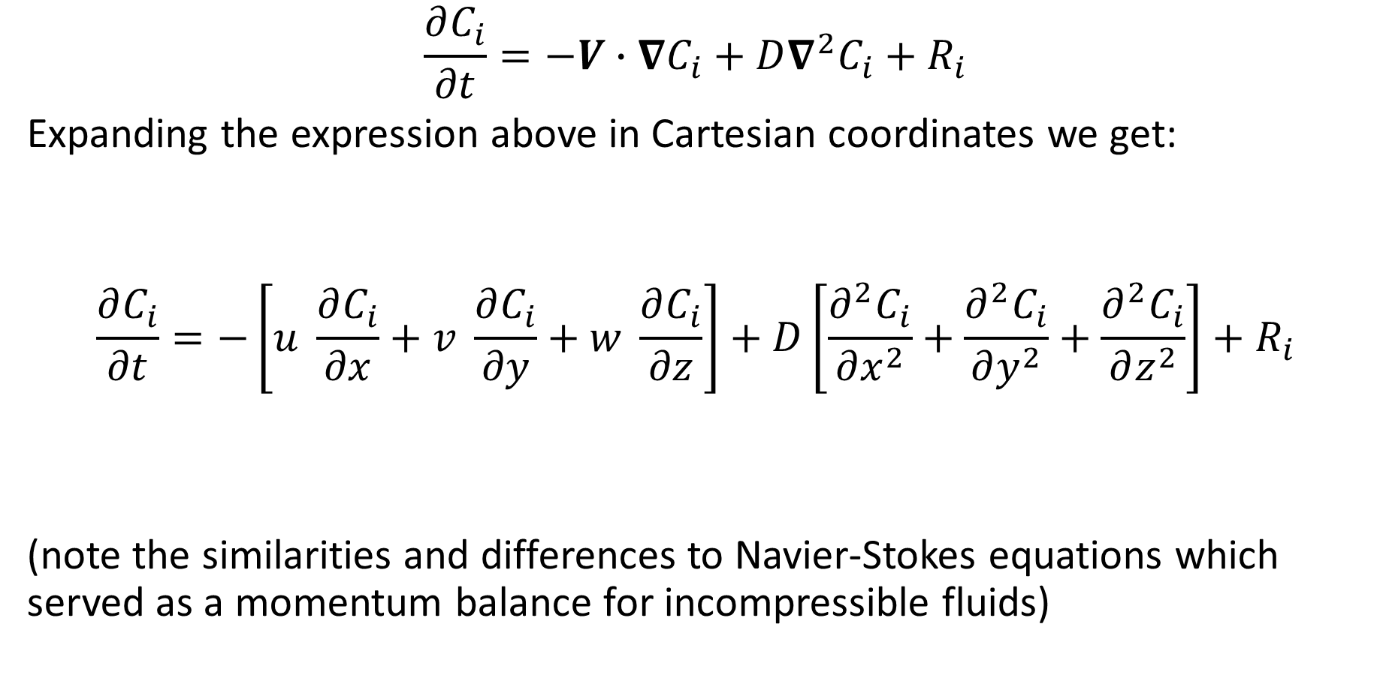
Conservation of Mass
$$\frac{∂C_{i}}{∂t}=−V∙∇C_{i}+D∇^{2}C_{i}+R_{i}$$
Expanding the expression above in Cartesian coordinates we get:
$$\frac{∂C_{i}}{∂t}=−\left[u \frac{∂C_{i}}{∂x}+v \frac{∂C_{i}}{∂y}+w \frac{∂C_{i}}{∂z}\right]+D\left[\frac{∂^{2}C_{i}}{∂x^{2}}+\frac{∂^{2}C_{i}}{∂y^{2}}+\frac{∂^{2}C_{i}}{∂z^{2}}\right]+R_{i}$$
(note the similarities and differences to Navier-Stokes equations which served as a momentum balance for incompressible fluids)

Slide 5
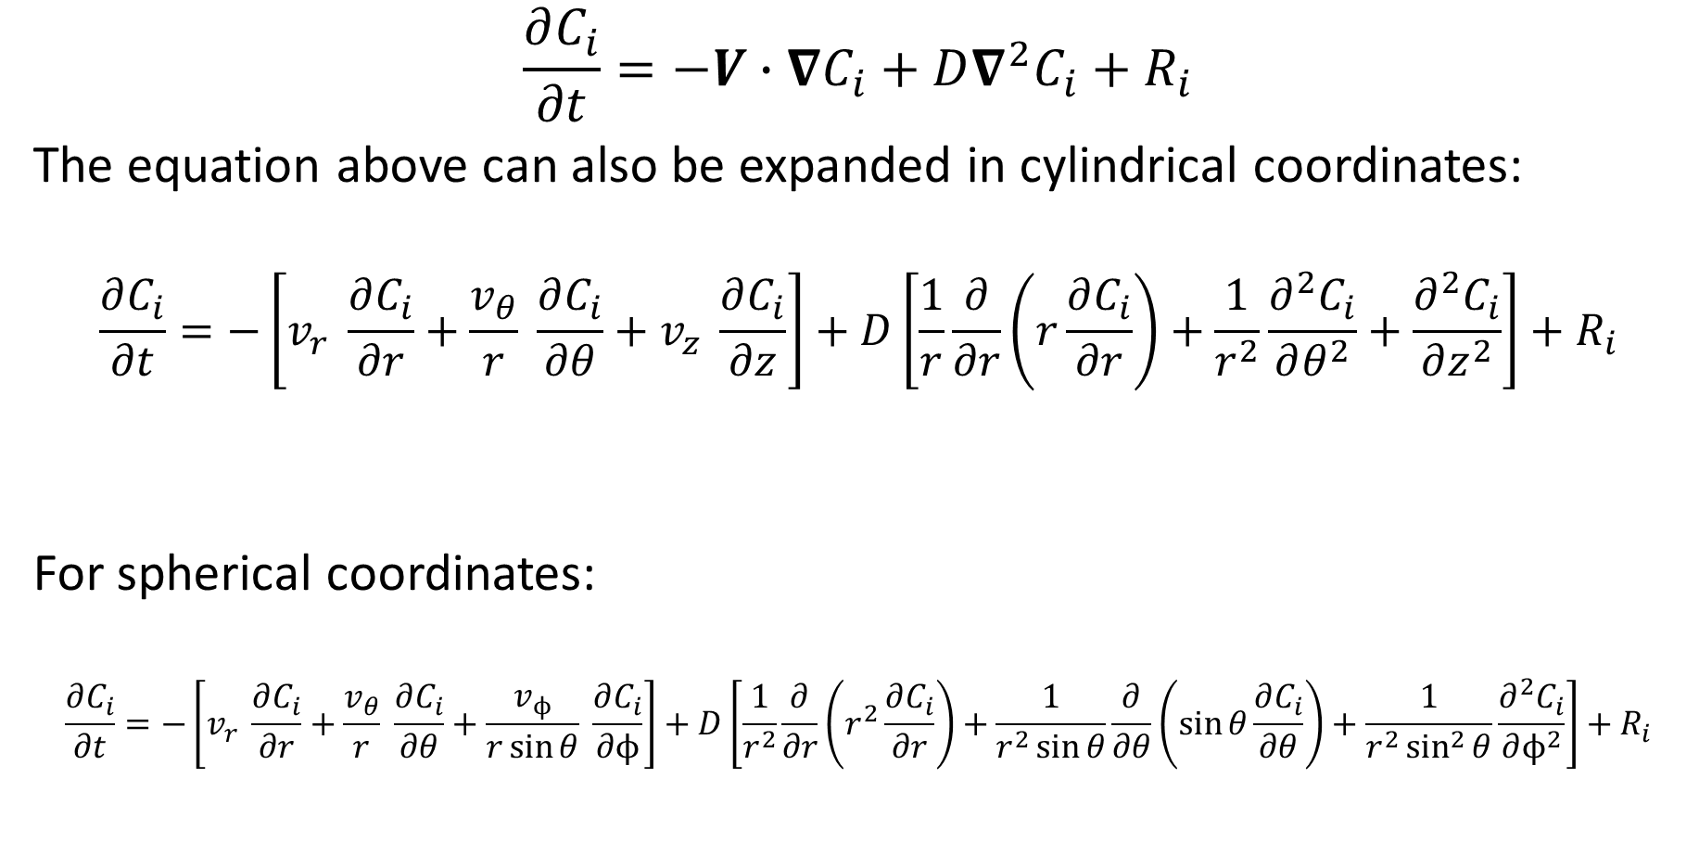
Conservation of Mass
$$\frac{∂C_{i}}{∂t}=−V∙∇C_{i}+D∇^{2}C_{i}+R_{i}$$
The equation above can also be expanded in cylindrical coordinates:
$$\frac{∂C_{i}}{∂t}=−\left[v_{r} \frac{∂C_{i}}{∂r}+\frac{v_{θ}}{r} \frac{∂C_{i}}{∂θ}+v_{z} \frac{∂C_{i}}{∂z}\right]+D\left[\frac{1}{r}\frac{∂}{∂r}\left(r\frac{∂C_{i}}{∂r}\right)+\frac{1}{r^{2}}\frac{∂^{2}C_{i}}{∂θ^{2}}+\frac{∂^{2}C_{i}}{∂z^{2}}\right]+R_{i}$$
For spherical coordinates:
$$\frac{∂C_{i}}{∂t}=−\left[v_{r} \frac{∂C_{i}}{∂r}+\frac{v_{θ}}{r} \frac{∂C_{i}}{∂θ}+\frac{v_{ϕ}}{r\sin{θ}} \frac{∂C_{i}}{∂ϕ}\right]+D\left[\frac{1}{r^{2}}\frac{∂}{∂r}\left(r^{2}\frac{∂C_{i}}{∂r}\right)+\frac{1}{r^{2}\sin{θ}}\frac{∂}{∂θ}\left(\sin{θ}\frac{∂C_{i}}{∂θ}\right)+\frac{1}{r^{2}\sin^{2}{θ}}\frac{∂^{2}C_{i}}{∂ϕ^{2}}\right]+R_{i}$$

Slide 6







Diffusion and Convection Example
Consider steady-state 1D diffusion and convection across a membrane of thickness L. Assume no chemical reactions occur within the membrane. Assume the concentration of a permeable solute at $x=0$ is $C_{0}$; the concentration at the opposite surface, $x=L$, is $C_{L}$. Determine the concentration profile and solute flux across the membrane.
$$u$$
$$C_{0}$$
$$u$$
$$C_{L}$$
$$x$$
$$L$$

Slide 7
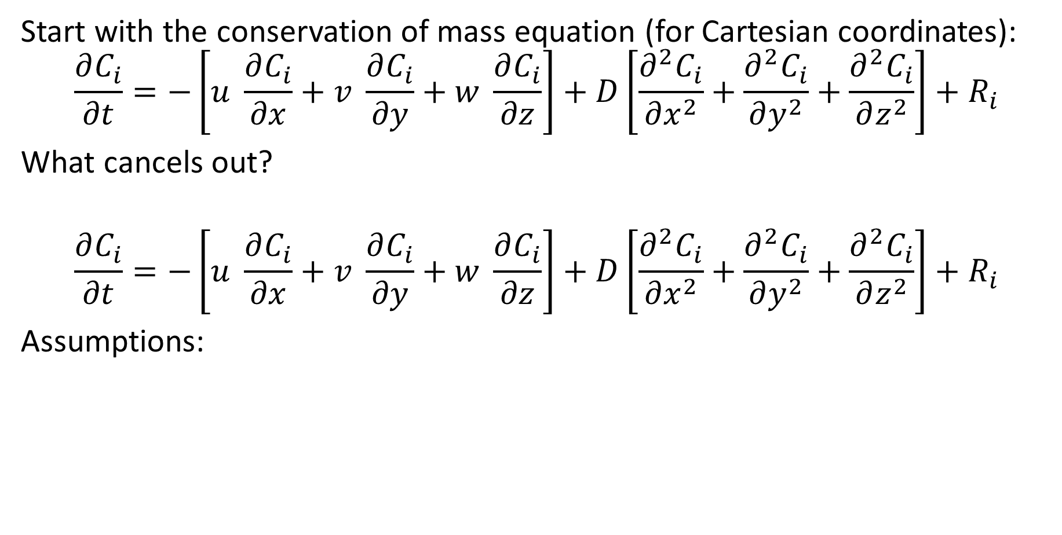
Diffusion and Convection Example
Start with the conservation of mass equation (for Cartesian coordinates):
$$\frac{∂C_{i}}{∂t}=−\left[u \frac{∂C_{i}}{∂x}+v \frac{∂C_{i}}{∂y}+w \frac{∂C_{i}}{∂z}\right]+D\left[\frac{∂^{2}C_{i}}{∂x^{2}}+\frac{∂^{2}C_{i}}{∂y^{2}}+\frac{∂^{2}C_{i}}{∂z^{2}}\right]+R_{i}$$
What cancels out?
$$\frac{∂C_{i}}{∂t}=−\left[u \frac{∂C_{i}}{∂x}+v \frac{∂C_{i}}{∂y}+w \frac{∂C_{i}}{∂z}\right]+D\left[\frac{∂^{2}C_{i}}{∂x^{2}}+\frac{∂^{2}C_{i}}{∂y^{2}}+\frac{∂^{2}C_{i}}{∂z^{2}}\right]+R_{i}$$
Assumptions:

Slide 8
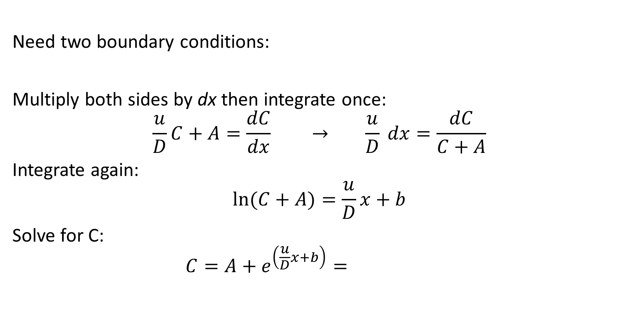
Diffusion and Convection Example
Need two boundary conditions:
Multiply both sides by dx then integrate once:
$$\frac{u}{D}C+A=\frac{dC}{dx} → \frac{u}{D} dx=\frac{dC}{C+A}$$
Integrate again:
$$\ln{(C+A)}=\frac{u}{D}x+b$$
Solve for C:
$$C=A+e^{\left(\frac{u}{D}x+b\right)}=$$

Slide 9
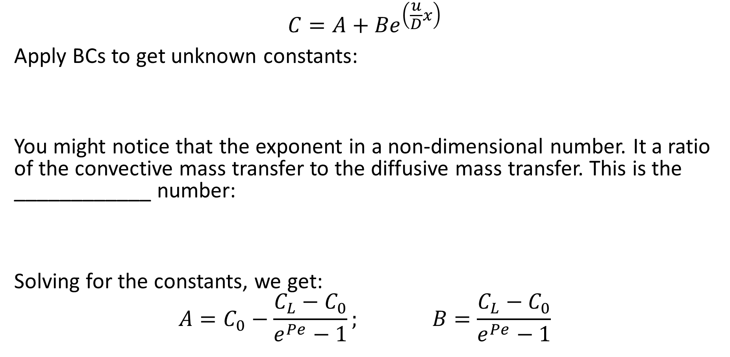
Diffusion and Convection Example
$$C=A+{Be}^{\left(\frac{u}{D}x\right)}$$
Apply BCs to get unknown constants:
You might notice that the exponent in a non-dimensional number. It a ratio of the convective mass transfer to the diffusive mass transfer. This is the ____________ number:
Solving for the constants, we get:
$$A=C_{0}−\frac{C_{L}−C_{0}}{e^{Pe}−1}; B=\frac{C_{L}−C_{0}}{e^{Pe}−1}$$

Slide 10
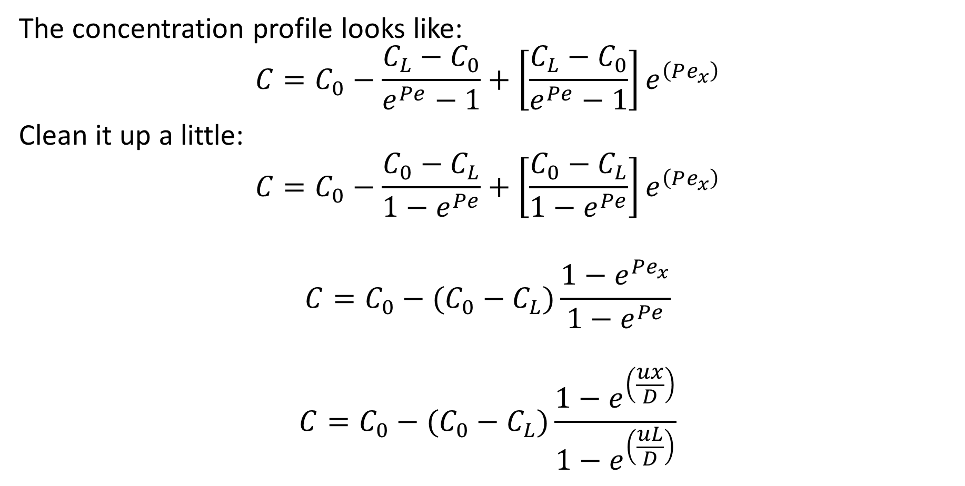
Diffusion and Convection Example
The concentration profile looks like:
$$C=C_{0}−\frac{C_{L}−C_{0}}{e^{Pe}−1}+{\left[\frac{C_{L}−C_{0}}{e^{Pe}−1}\right]e}^{\left(Pe_{x}\right)}$$
Clean it up a little:
$$C=C_{0}−\frac{C_{0}−C_{L}}{1−e^{Pe}}+{\left[\frac{C_{0}−C_{L}}{1−e^{Pe}}\right]e}^{\left(Pe_{x}\right)}$$
$$C=C_{0}−(C_{0}−C_{L})\frac{1−e^{Pe_{x}}}{1−e^{Pe}}$$
$$C=C_{0}−(C_{0}−C_{L})\frac{1−e^{\left(\frac{ux}{D}\right)}}{1−e^{\left(\frac{uL}{D}\right)}}$$

Slide 11

Diffusion and Convection Example
$$C(x)=C_{0}−(C_{0}−C_{L})\frac{1−e^{\left(\frac{ux}{D}\right)}}{1−e^{\left(\frac{uL}{D}\right)}}$$
We can express this in non-dimensional terms:
$$C(x)−C_{L}=C_{0}−C_{L}−(C_{0}−C_{L})\frac{1−e^{\left(\frac{ux}{D}\right)}}{1−e^{\left(\frac{uL}{D}\right)}}$$

Slide 12
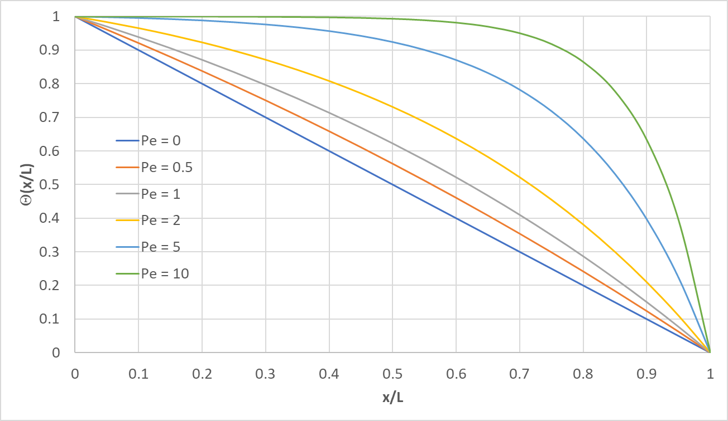
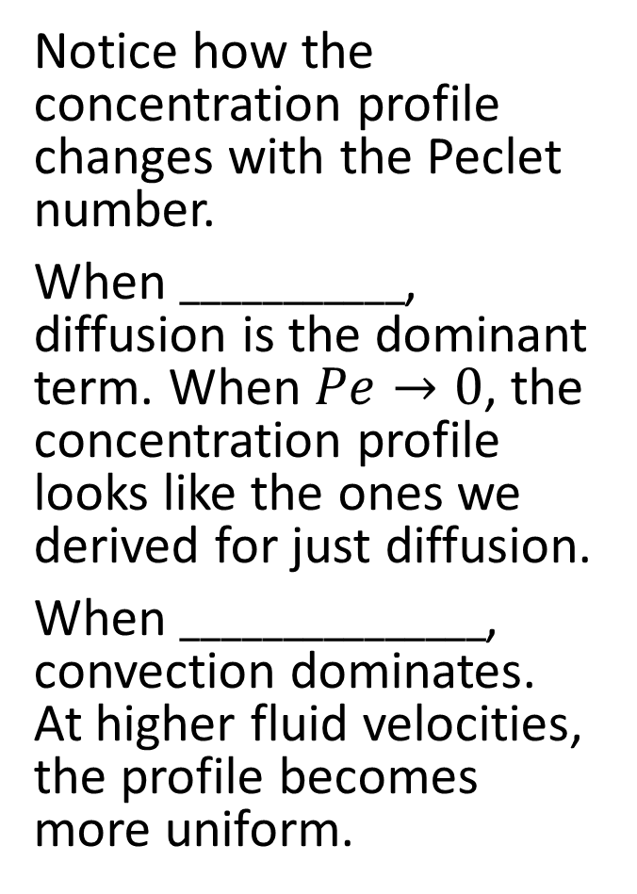
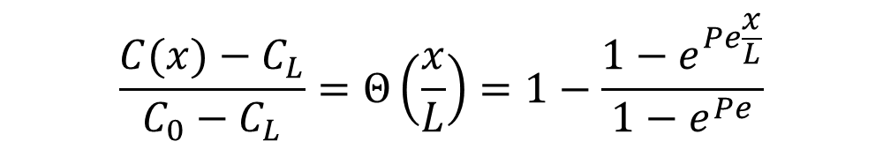
Diffusion and Convection Example
$$\frac{C(x)−C_{L}}{C_{0}−C_{L}}=Θ\left(\frac{x}{L}\right)=1−\frac{1−e^{Pe\frac{x}{L}}}{1−e^{Pe}}$$
Notice how the concentration profile changes with the Peclet number.
When $___________$, diffusion is the dominant term. When $Pe→0$, the concentration profile looks like the ones we derived for just diffusion.
When $_______________$, convection dominates. At higher fluid velocities, the profile becomes more uniform.

Slide 13

Diffusion and Convection Example
$$C=C_{0}−(C_{0}−C_{L})\frac{1−e^{Pe\frac{x}{L}}}{1−e^{Pe}}$$
Now let’s determine the flux
$$n_{s}=$$
$$\frac{dC}{dx}=\frac{Pe}{L}\left(C_{0}−C_{L}\right)\frac{e^{Pe\frac{x}{L}}}{1−e^{Pe}}$$
$$n_{s}=−D\left[\frac{Pe}{L}\left(C_{0}−C_{L}\right)\frac{e^{Pe\frac{x}{L}}}{1−e^{Pe}}\right]+u\left[C_{0}−(C_{0}−C_{L})\frac{1−e^{Pe\frac{x}{L}}}{1−e^{Pe}}\right]$$

Slide 14

Diffusion and Convection Example
$$n_{s}=−D\left[\frac{Pe}{L}\left(C_{0}−C_{L}\right)\frac{e^{Pe\frac{x}{L}}}{1−e^{Pe}}\right]+\frac{uL}{D}\frac{D}{L}\left[C_{0}−(C_{0}−C_{L})\frac{1−e^{Pe\frac{x}{L}}}{1−e^{Pe}}\right]$$

Slide 15
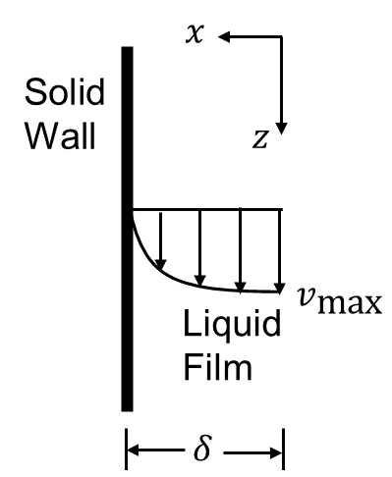
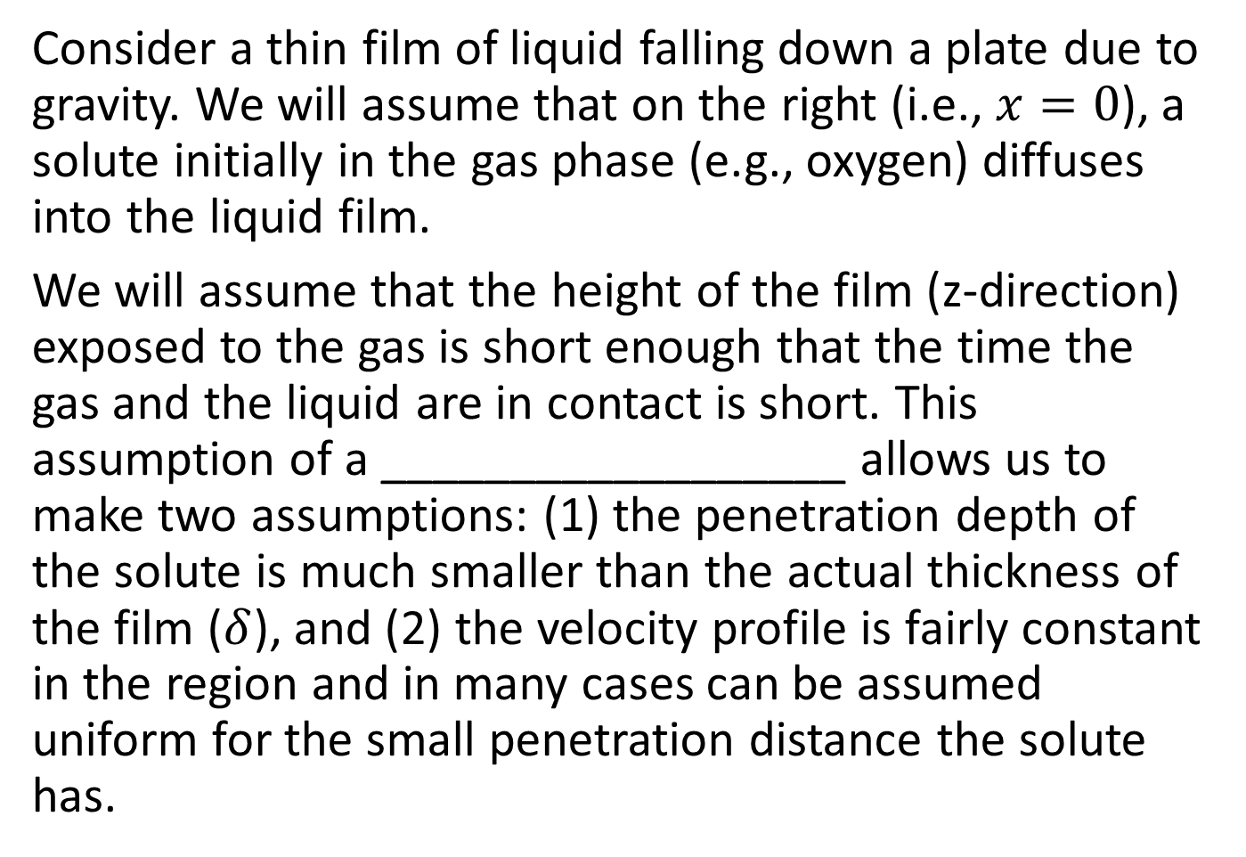
Diffusion into a Falling Liquid
Consider a thin film of liquid falling down a plate due to gravity. We will assume that on the right (i.e., $x=0$), a solute initially in the gas phase (e.g., oxygen) diffuses into the liquid film.
We will assume that the height of the film (z-direction) exposed to the gas is short enough that the time the gas and the liquid are in contact is short. This assumption of a __________________ allows us to make two assumptions: (1) the penetration depth of the solute is much smaller than the actual thickness of the film ($δ$), and (2) the velocity profile is fairly constant in the region and in many cases can be assumed uniform for the small penetration distance the solute has.

Slide 16

Diffusion into a Falling Liquid
Start with the mass balance
$$\frac{∂C_{i}}{∂t}=−\left[u \frac{∂C_{i}}{∂x}+v \frac{∂C_{i}}{∂y}+w \frac{∂C_{i}}{∂z}\right]+D\left[\frac{∂^{2}C_{i}}{∂x^{2}}+\frac{∂^{2}C_{i}}{∂y^{2}}+\frac{∂^{2}C_{i}}{∂z^{2}}\right]+R_{i}$$
What assumptions can we make?

Slide 17
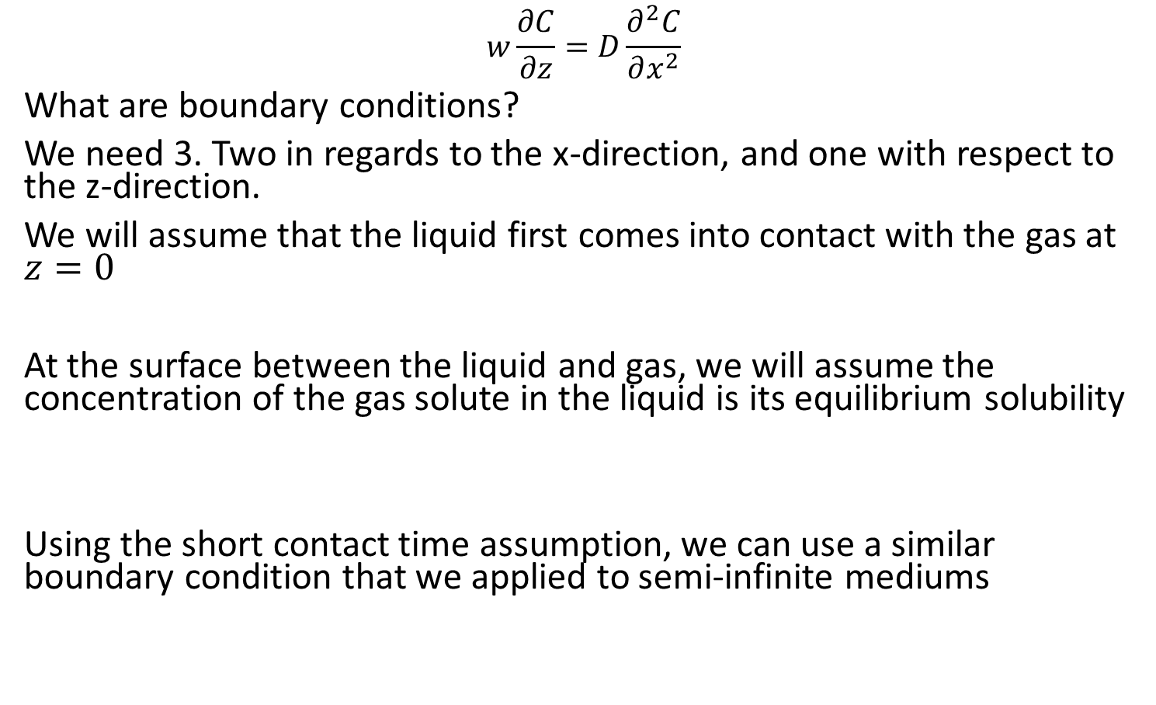
Diffusion into a Falling Liquid
$$w\frac{∂C}{∂z}=D\frac{∂^{2}C}{∂x^{2}}$$
What are boundary conditions?
We need 3. Two in regards to the x-direction, and one with respect to the z-direction.
We will assume that the liquid first comes into contact with the gas at $z=0$
At the surface between the liquid and gas, we will assume the concentration of the gas solute in the liquid is its equilibrium solubility
Using the short contact time assumption, we can use a similar boundary condition that we applied to semi-infinite mediums

Slide 18
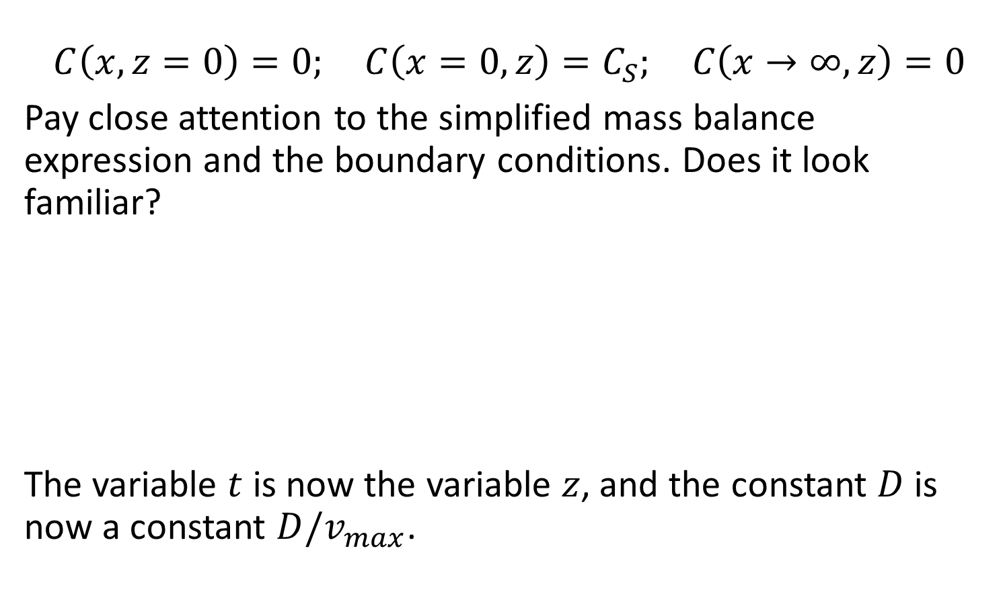
Diffusion into a Falling Liquid
$$C\left(x,z=0\right)=0; C\left(x=0,z\right)=C_{S}; C\left(x→∞,z\right)=0$$
Pay close attention to the simplified mass balance expression and the boundary conditions. Does it look familiar?
The variable $t$ is now the variable $z$, and the constant $D$ is now a constant $D/v_{max}$.

Slide 19

Diffusion into a Falling Liquid
$$\frac{∂C}{∂z}=\frac{D}{w}\frac{∂^{2}C}{∂x^{2}}$$
$$C\left(x,z=0\right)=0; C\left(x=0,z\right)=C_{S}; C\left(x→∞,z\right)=0$$
The solution:
$$C\left(x,z\right)=C_{S}\operatorname{erfc}\left(\frac{x}{\sqrt{\frac{4D}{v_{max}} z}}\right)=$$

Slide 20
Boundary Layer Thickness and Contact Time
Like previously, we can develop an expression for determining the concentration boundary layer thickness as a function of location (z, instead of time).
Setting the contents insider the erfc function to 2 (or 1.821 for a more accurate solution)

Slide 21
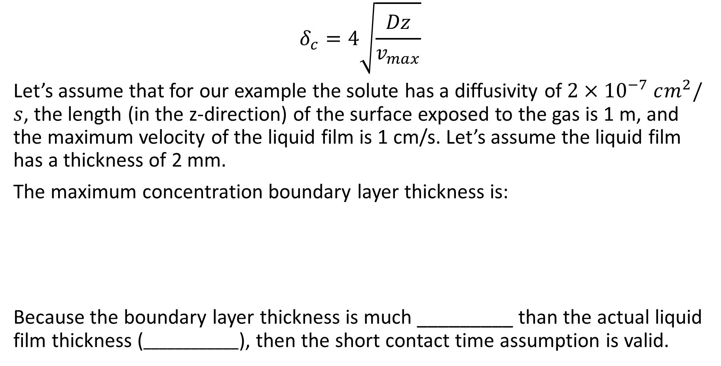
Boundary Layer Thickness and Contact Time
$$δ_{c}=4\sqrt{\frac{Dz}{v_{max}}}$$
Let’s assume that for our example the solute has a diffusivity of $2×{10}^{−7} cm^{2}/s$, the length (in the z-direction) of the surface exposed to the gas is 1 m, and the maximum velocity of the liquid film is 1 cm/s. Let’s assume the liquid film has a thickness of 2 mm.
The maximum concentration boundary layer thickness is:
Because the boundary layer thickness is much _________ than the actual liquid film thickness ($____________$), then the short contact time assumption is valid.

Slide 22
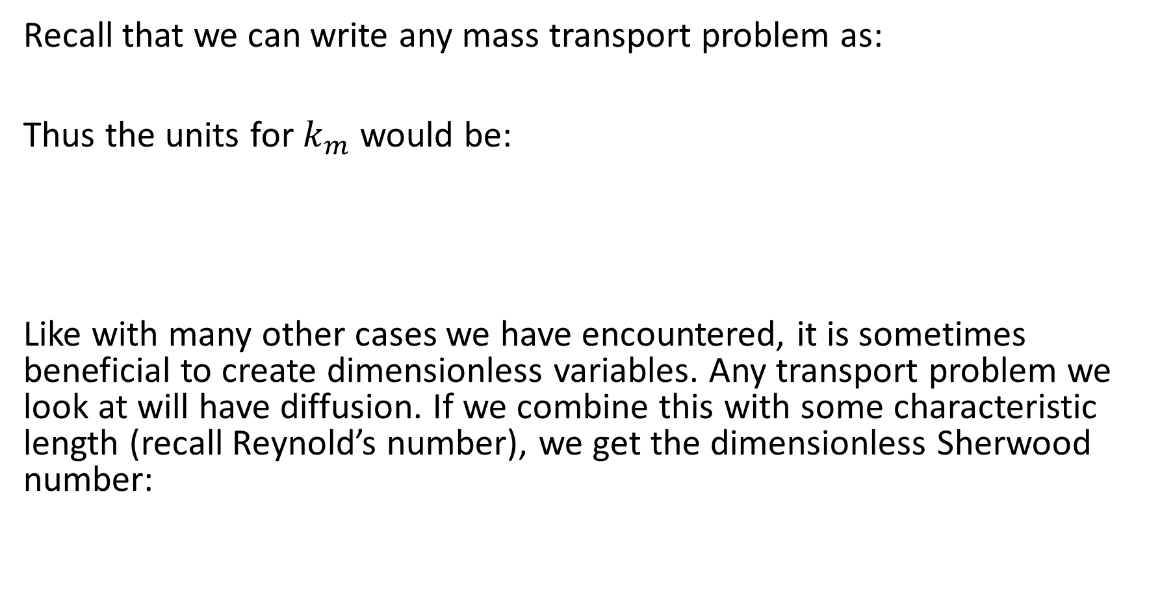
Mass Transfer Coefficient and Sherwood Number
Recall that we can write any mass transport problem as:
Thus the units for $k_{m}$ would be:
Like with many other cases we have encountered, it is sometimes beneficial to create dimensionless variables. Any transport problem we look at will have diffusion. If we combine this with some characteristic length (recall Reynold’s number), we get the dimensionless Sherwood number:

Slide 23
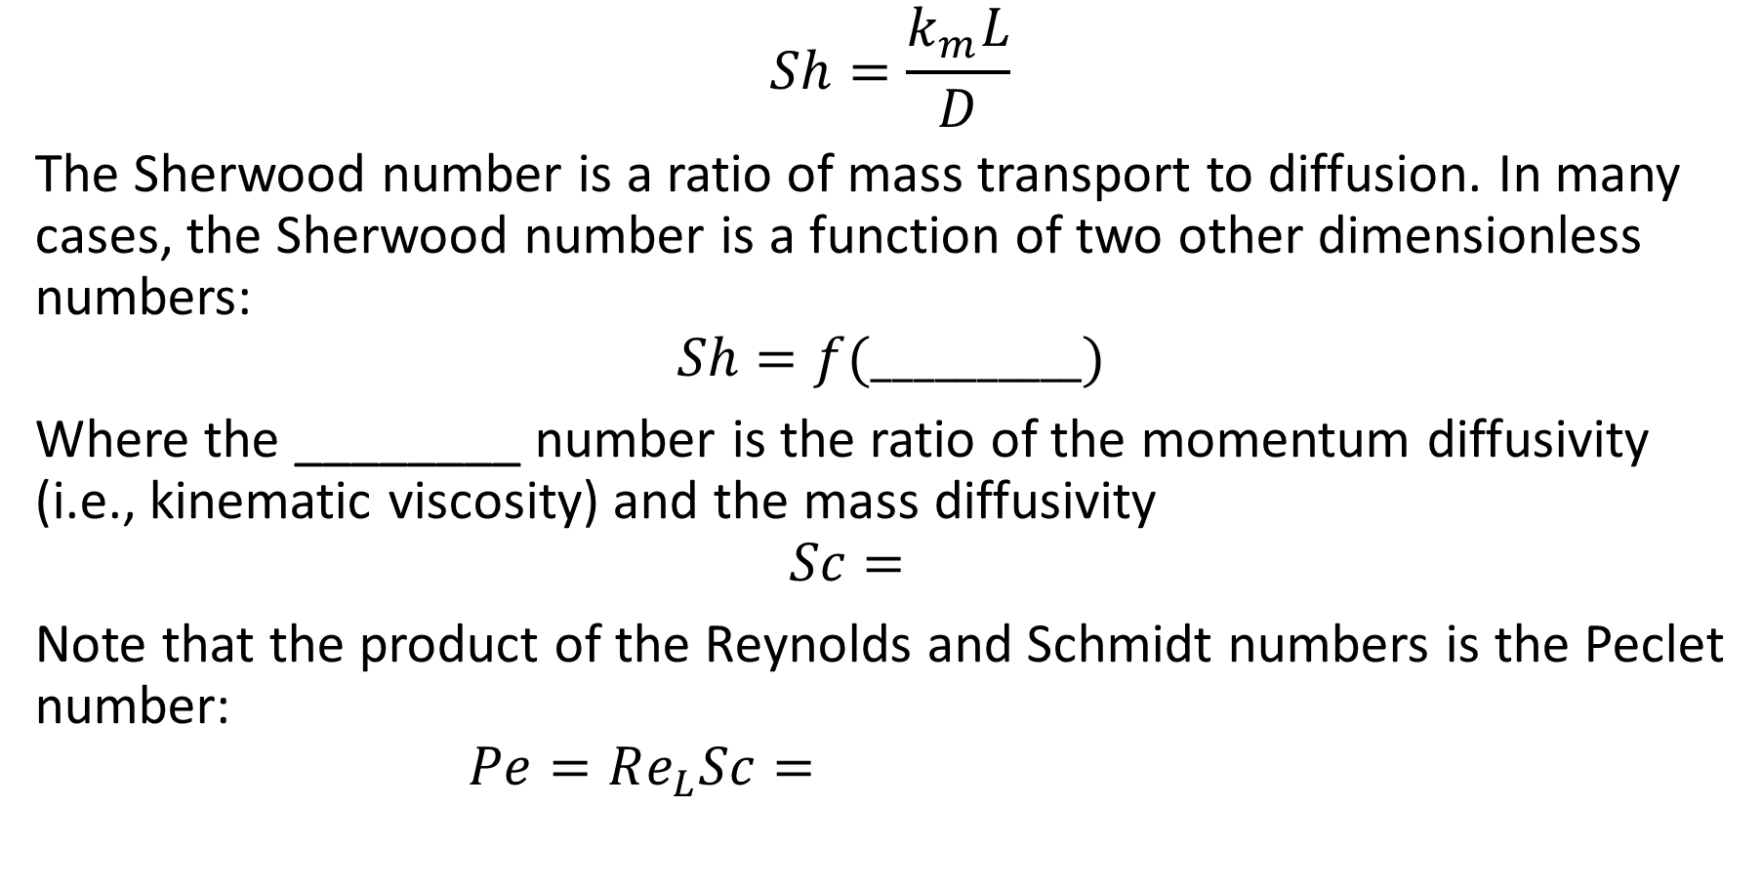
Sherwood Number
$$Sh=\frac{k_{m}L}{D}$$
The Sherwood number is a ratio of mass transport to diffusion. In many cases, the Sherwood number is a function of two other dimensionless numbers:
$$Sh=f(__________)$$
Where the ________ number is the ratio of the momentum diffusivity (i.e., kinematic viscosity) and the mass diffusivity
$$Sc=$$
Note that the product of the Reynolds and Schmidt numbers is the Peclet number:
$$Pe=Re_{L}Sc=$$

Slide 24
Sherwood Number
As numerous studies have been conducted to study how mass transfer occurs in various scenarios, there are tables that can tell us how to calculate the Sherwood number with known parameters (usually the Reynolds and Schmidt numbers).
There is a table in your book (Table 5.2 A) that show expressions used to calculate the Sherwood numbers (and thus the mass transfer coefficients) for various geometries and scenarios.
Let’s take another look at the falling liquid film example.

Slide 25

Sherwood Number for Falling Film
$$k_{m}=−\frac{j}{ΔC}=−\frac{D}{ΔC} \frac{∂C}{∂x}{\left.​\right|}_{x=0}$$
$$C= C_{S}\operatorname{erfc}\left(\sqrt{\frac{v_{max}}{4Dz }}x\right)$$
$$j_{s}=−DC_{S}{\left[−\frac{\sqrt{v_{max}}}{\sqrt{πDz}} e^{−{\left(\frac{\sqrt{v_{max}}x}{\sqrt{4Dz}}\right)}^{2}}\right]}_{x=0}=\frac{\sqrt{Dv_{max}}C_{S}}{\sqrt{πz}}$$

Slide 26
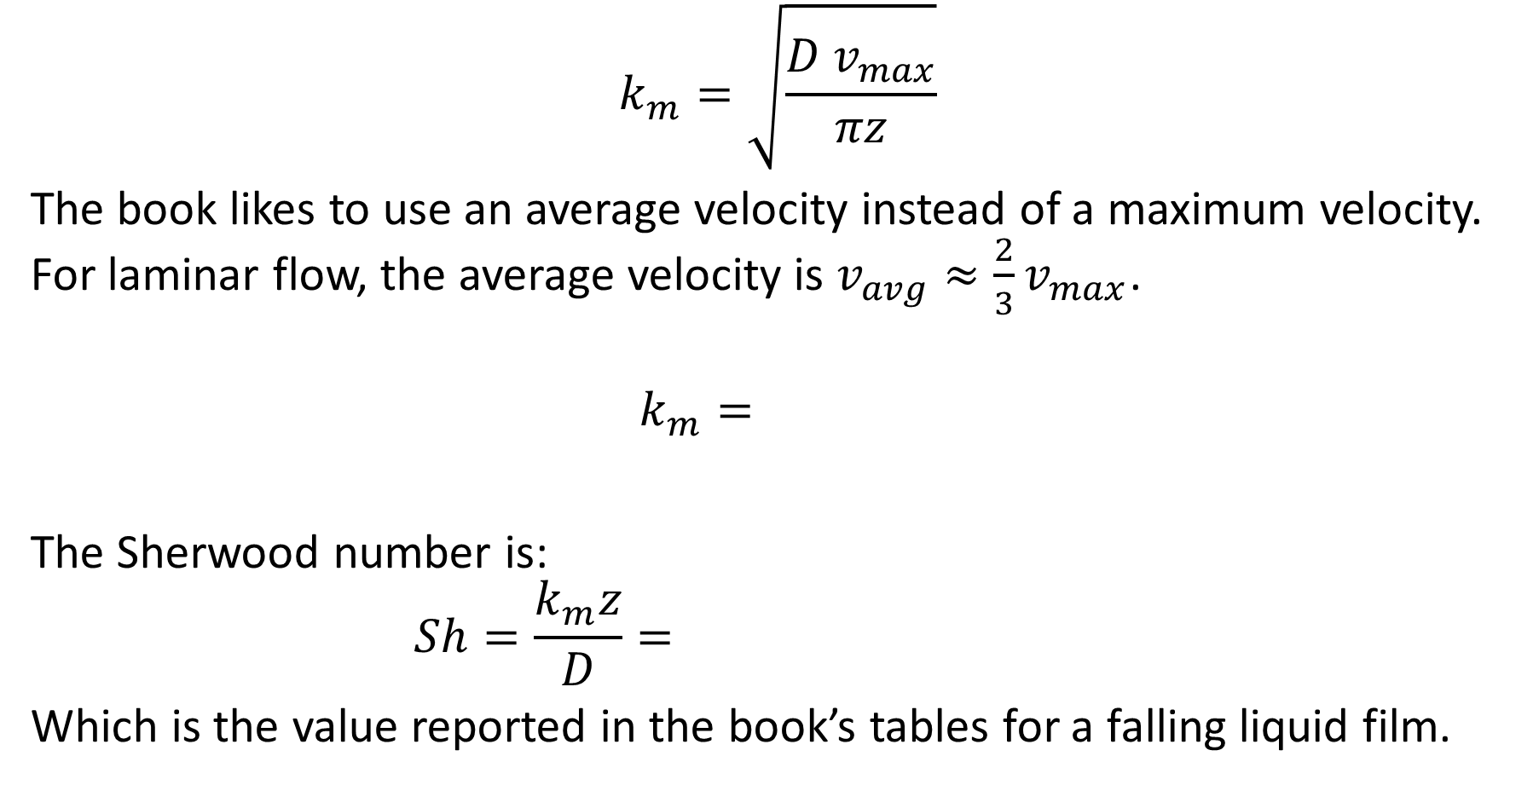
Sherwood Number for Falling Film
$$k_{m}=\sqrt{\frac{D v_{max}}{πz}}$$
The book likes to use an average velocity instead of a maximum velocity. For laminar flow, the average velocity is $v_{avg}≈\frac{2}{3}v_{max}$.
$$k_{m}=$$
The Sherwood number is:
$$Sh=\frac{k_{m}z}{D}=$$
Which is the value reported in the book’s tables for a falling liquid film.

